Slide 1

Remote Sensing in Observing Hydrologic Cycle
Zhi Li, PhD
Postdoc fellow at Stanford University
the 2024 WATER Summer School

Slide 2
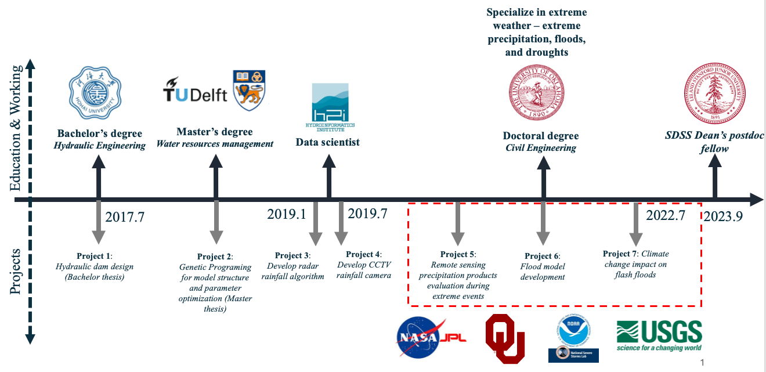
README

Slide 3
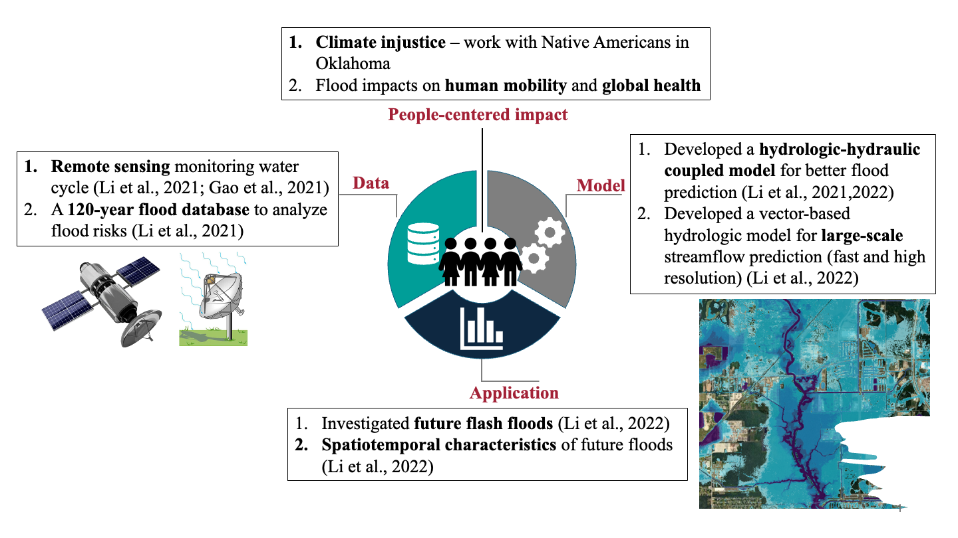
README

Slide 4
README

Slide 5
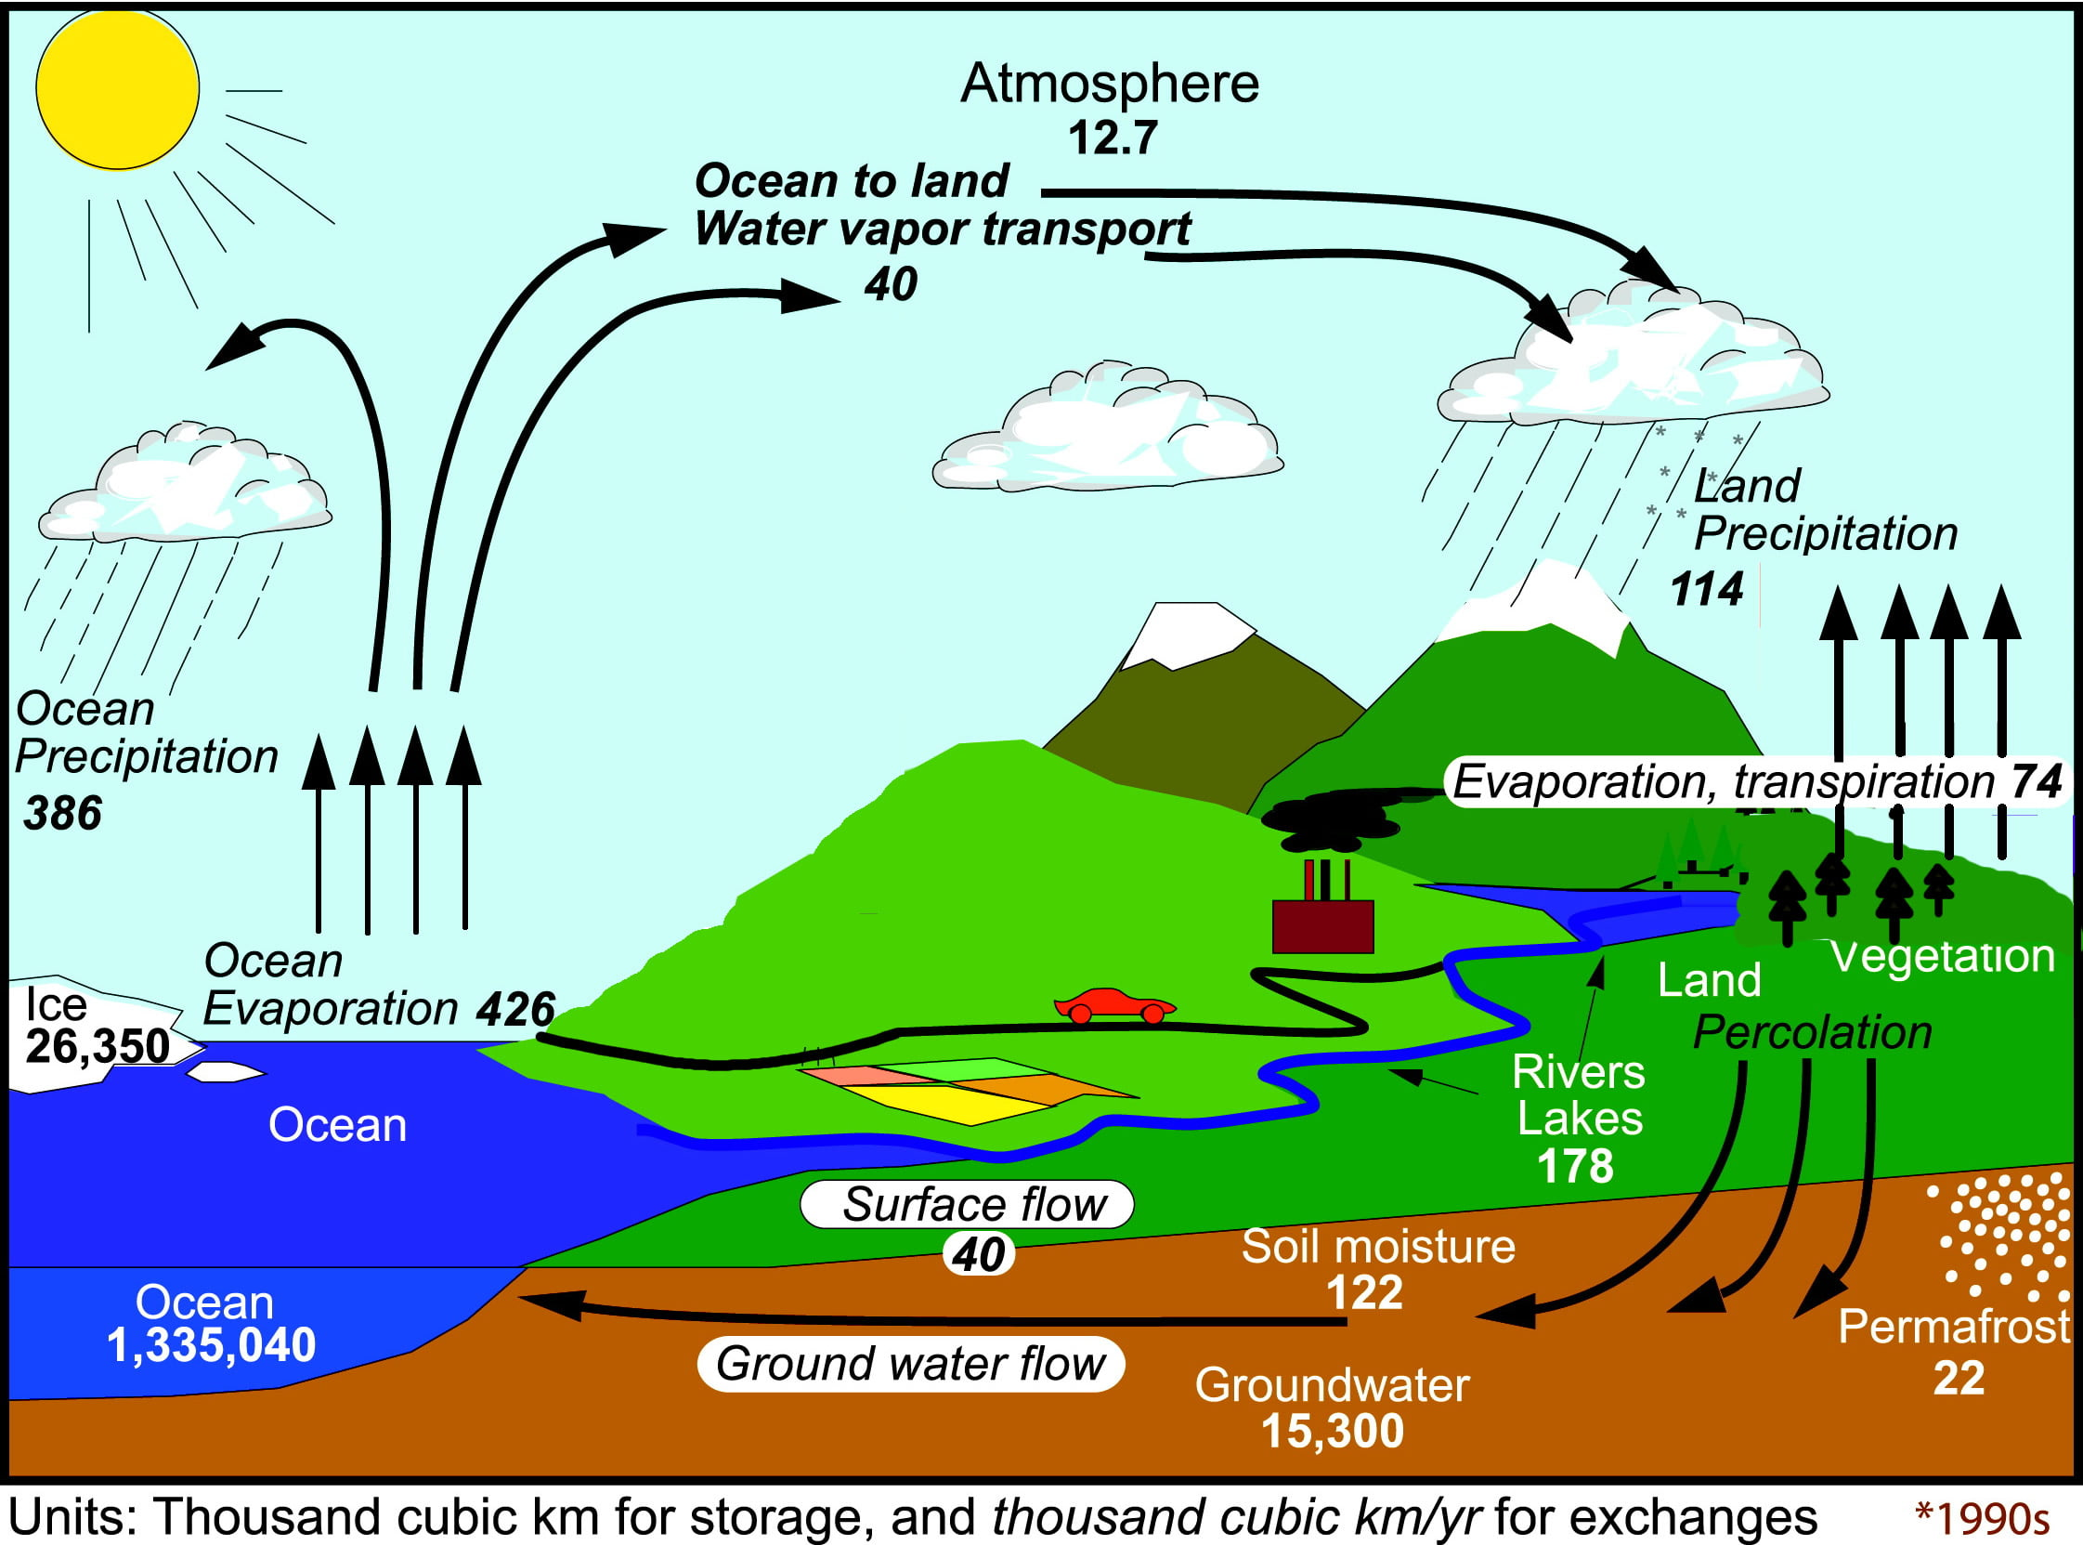
The water cycle
Observations from 2002 - 2008
Notes:
Fluxes: precipitation, evaporation, surface flow, groundwater flow, water vapor transport
States: ocean, surface water, soil moisture, groundwater

Slide 6
Q: What is the most fascinating part of the water cycle for you? (1 min)
a) Precipitation
b) Evaporation
c) Transpiration
d) Soil moisture
e) Groundwater
f) Surface water

Slide 7
The water cycle
Observations from 2002 - 2008

Slide 8
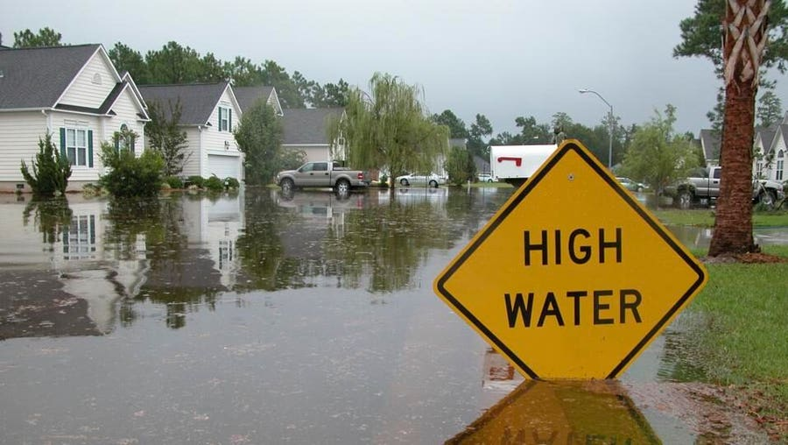
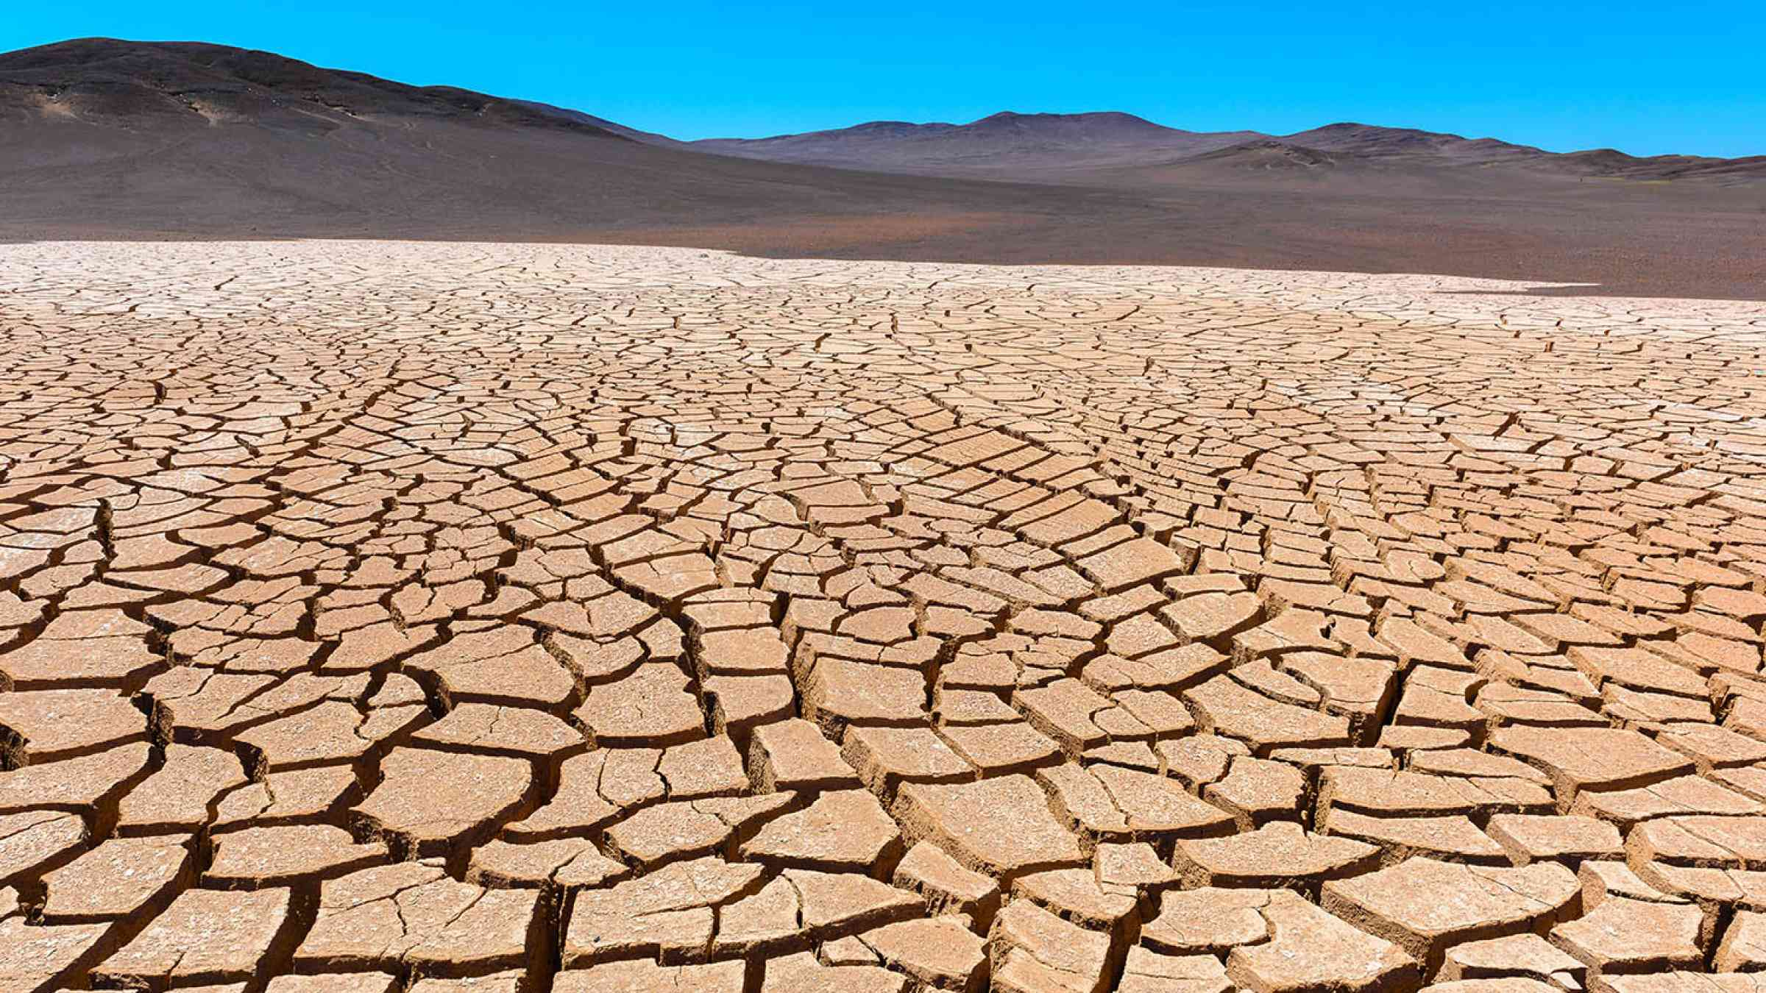
Too much and too little
Too much water
Too little water

Slide 9
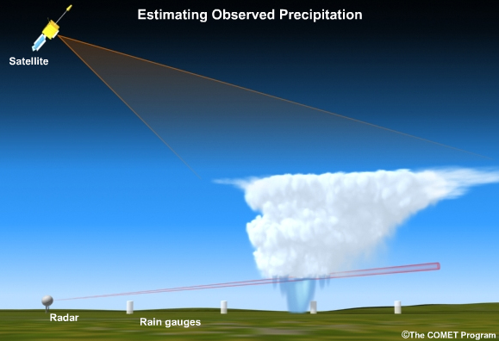
How do we measure precipitation?

Slide 10
Q: Which product(s) have you used in your research? (1 min)
a) Rain gauges
b) Ground weather radar
c) Satellite
d) Others

Slide 11
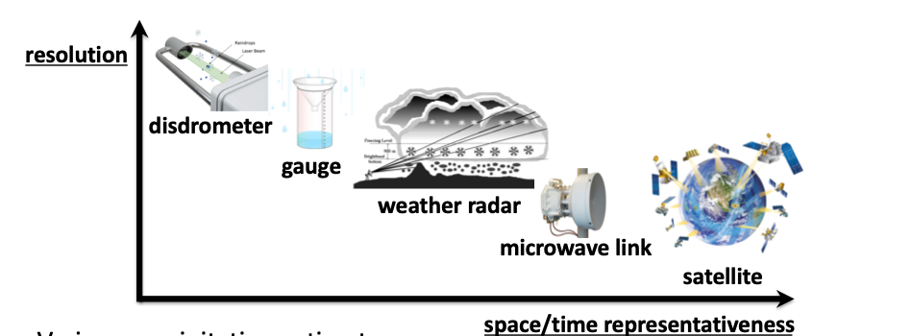
Precipitation sensors
Notes:
Tradeoff between data resolution and space/time representativeness

Slide 12
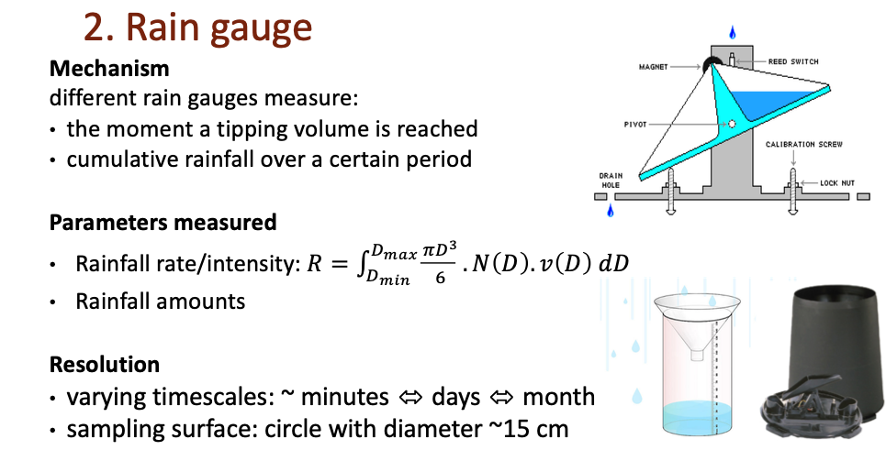
Rain gauges

Slide 13
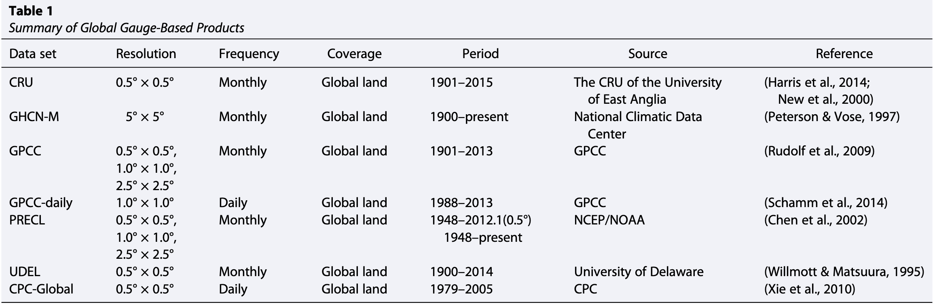
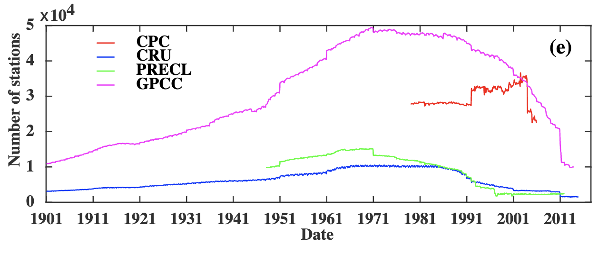
Popular and available precipitation products (Gauges)
Sun et al., 2018

Slide 14
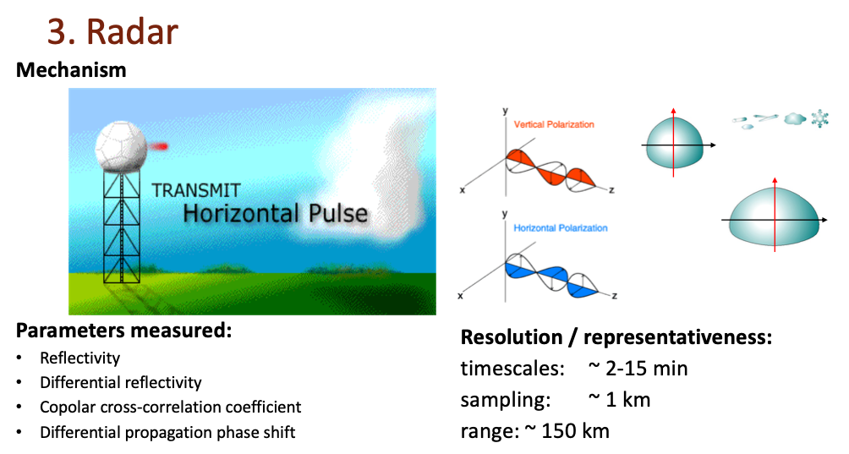
Radar

Slide 15
Popular and available precipitation products (radar)
Dataset | Resolution | Frequency | Coverage | Period | Source | Reference
MRMS | 1 km | 2 min / 1 hour | US | 2001 - 2011 2014 - now | NSSL/NOAA | Zhang et al. (2016) Zhang & Gourley (2018)
Stage IV | 4 km | 1 hour / 6 hour / 24 hour | US | 2001 - now | EOL/NCAR | Du, (2011)
NEXRAD L3 | 250 m | 5 min | US (individual radar site) | Mid 1990s - now | NCEP/NOAA | Krajewski et al. (2011)

Slide 16
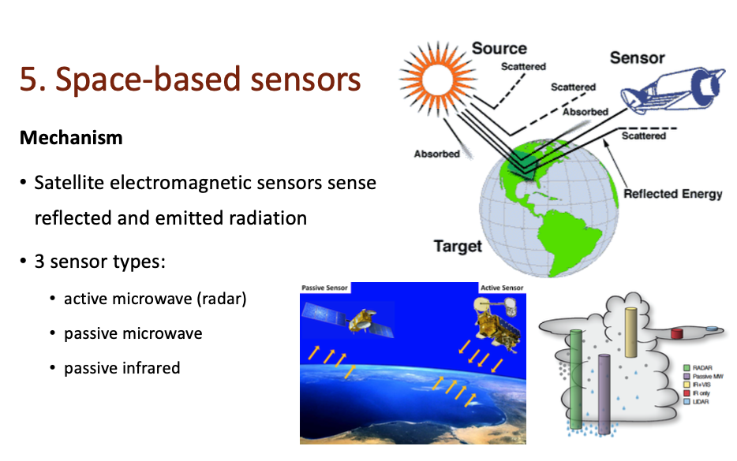
Satellite

Slide 17
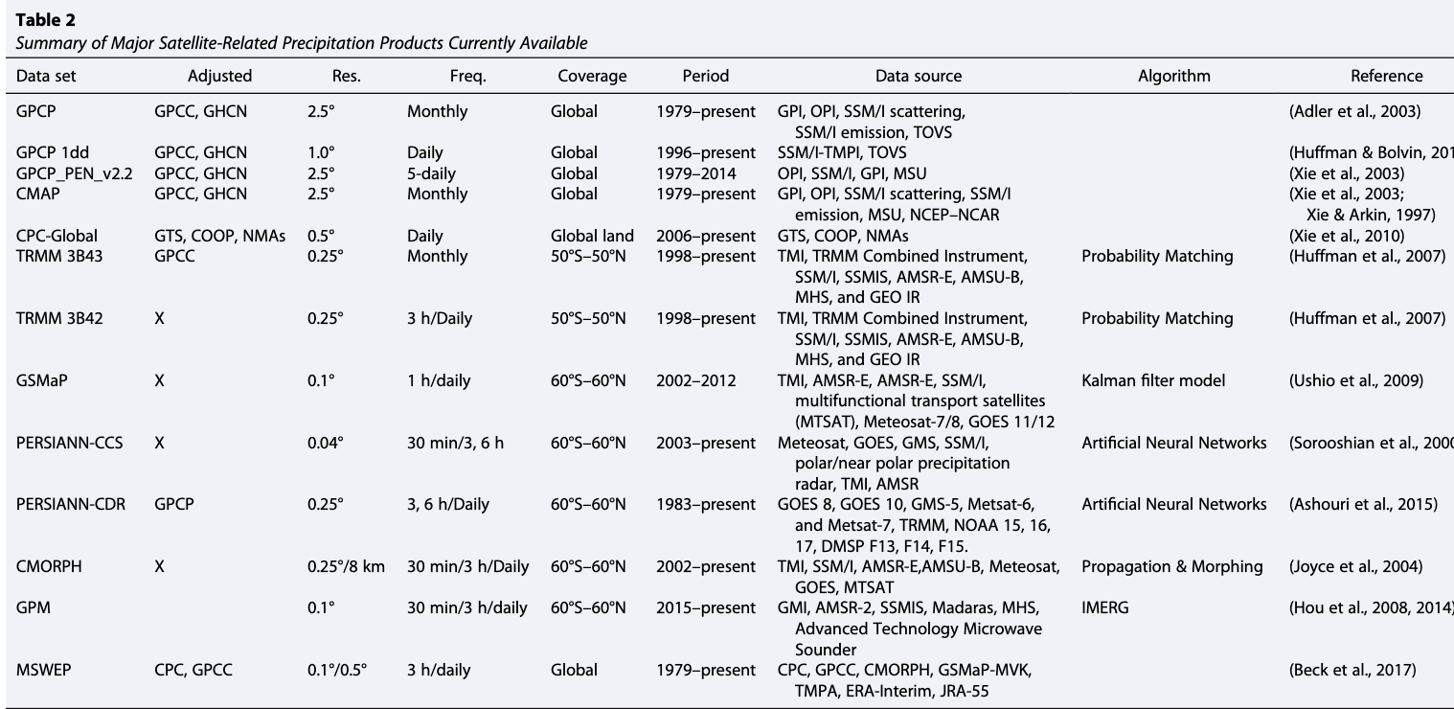
Popular and available precipitation products (satellite)
Sun et al., 2018

Slide 18
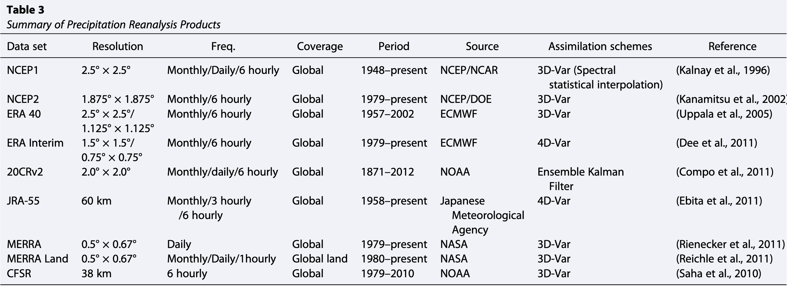
Popular and available precipitation products (reanalysis)
Sun et al., 2018

Slide 19
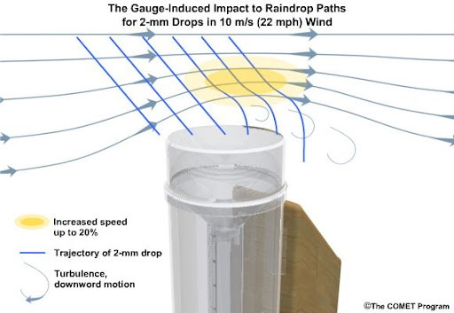
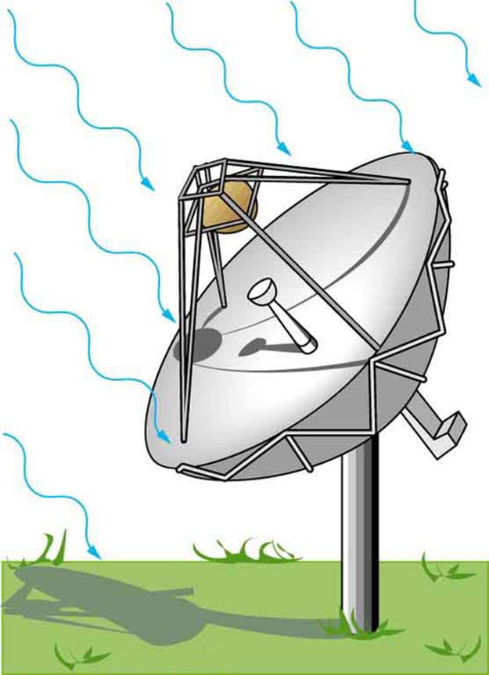
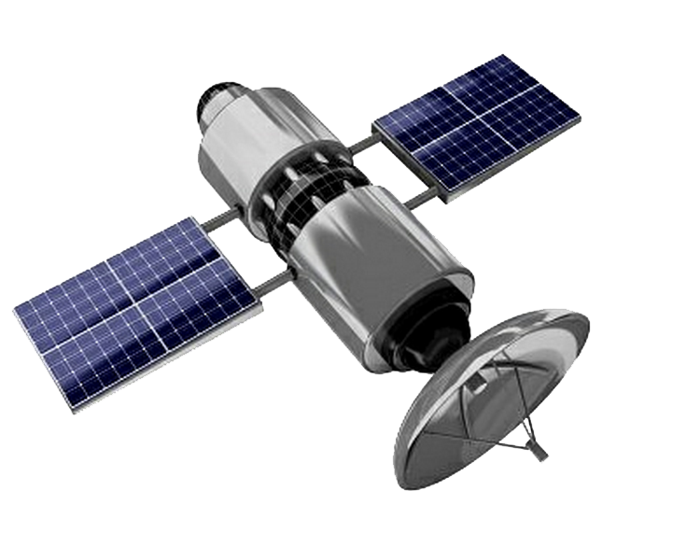
They are NOT as accurate as you thought
Z-R relation and difficulty identifying hydrometeors
Beam blockage
Indirect and infrequent estimates
Wind-induced loss of rain can reach up to 50%

Slide 20
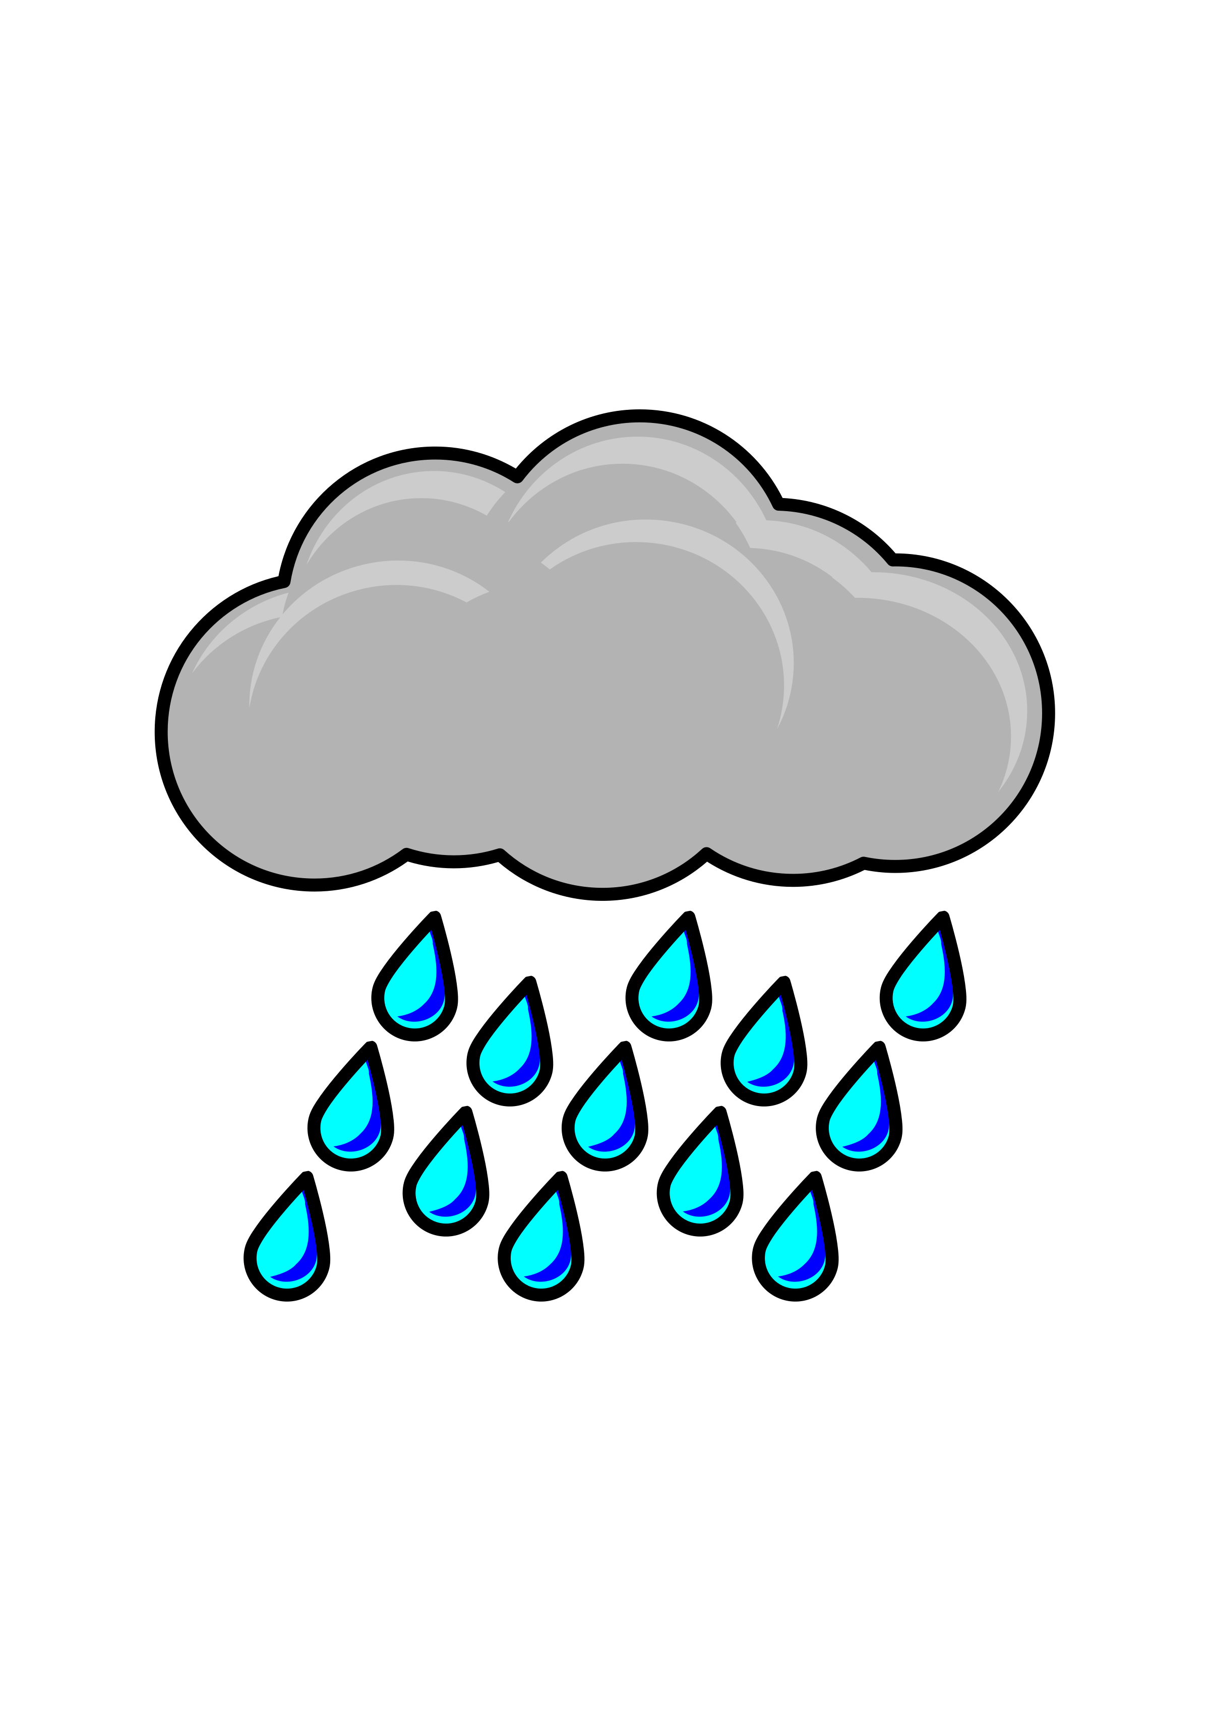

Even worse, when you propagate bias into hydrologic simulation …
Snowball effect
Precipitation
Lake
Reach
Catchment
Streamflow

Slide 21
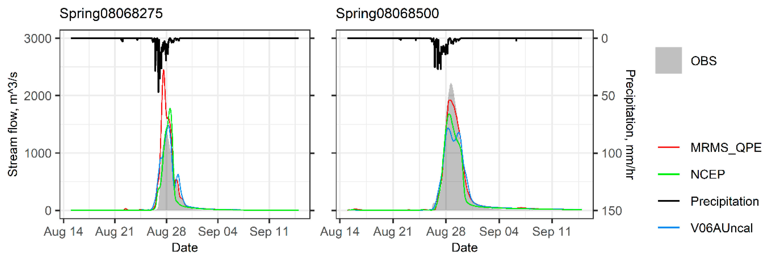
Boosted error in hydrologic simulation
Chen et al. 2020

Slide 22
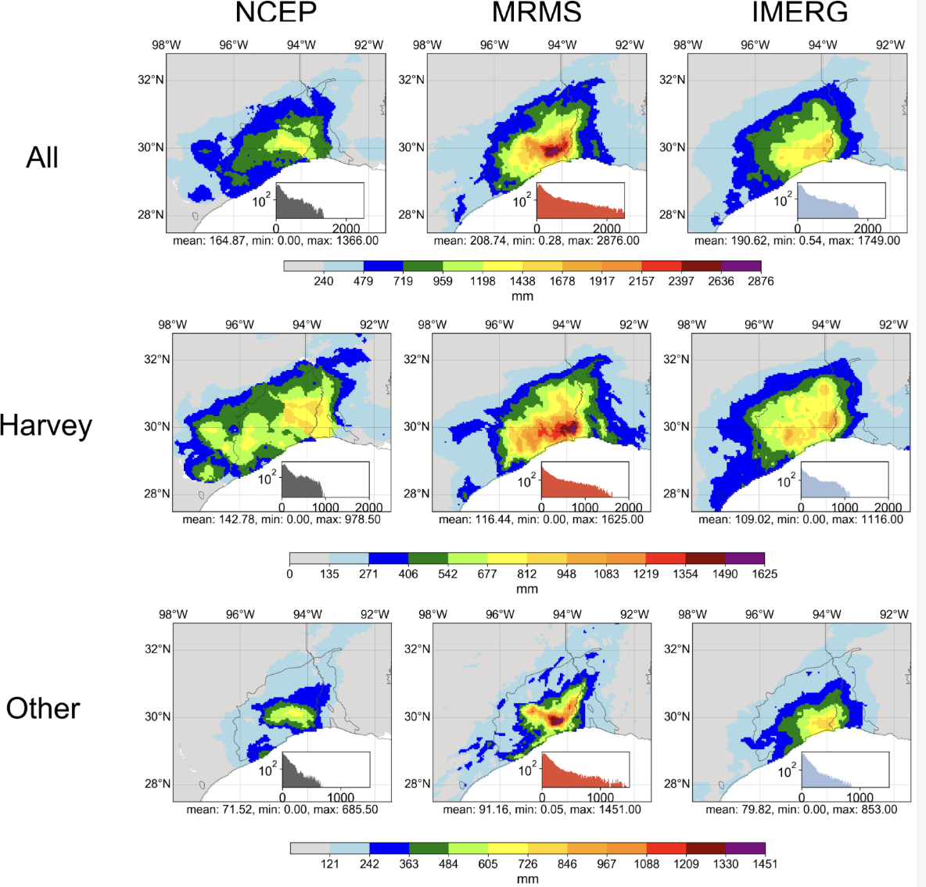
Understanding the quality of each product is the KEY
Discrepancies among satellite-only, radar-only, and gauge-only precipitation product during extreme weather events
Li et al. 2020

Slide 23
Q: which product you would choose for an extreme event like Hurricane Harvey? (1 min)
a) Rain gauges
b) Ground weather radar
c) Satellite
d) Reanalysis

Slide 24
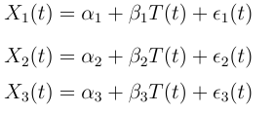
Introducing Triple Collocation
Assumptions:
Three products are independent
the errors of the datasets should be independent or unrelated
The expectation of error is treated as zero
Linear error model

Slide 25
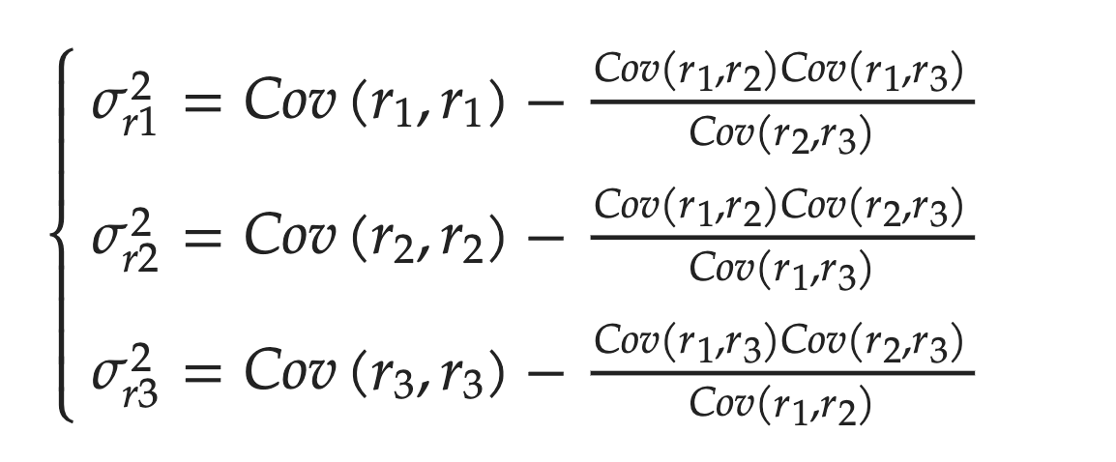
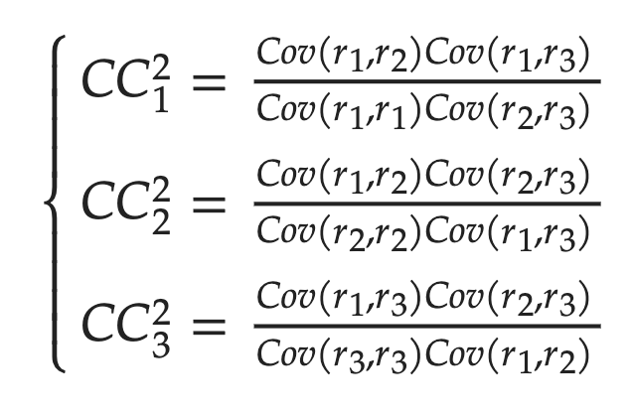
Introducing Triple Collocation (Ctn’ed)
Triple errors
Triple correlation

Slide 26
Coding session workflow
Select domain
Region overall
Overall performance
Outcome
Download data
Spatial dist.
Grid-level
Clip to the study region
Geospatial processing
GDAL
Matching
TC processing
COLAB

Slide 27
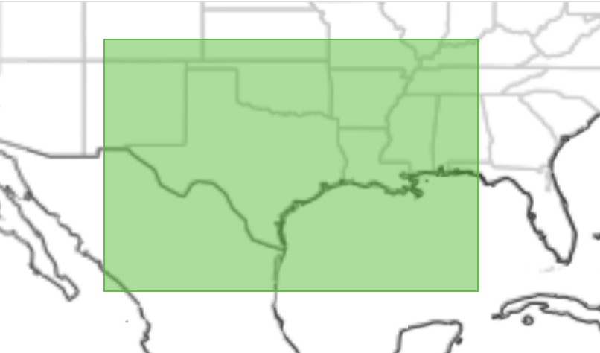
Case study – Hurricane Harvey
Region:
-107.9,23.5,-85.9,38.3
Satellite data – IMERG V07
- Variable: Early Run & PrecipitationUnCal
- download link: https://disc.gsfc.nasa.gov/datasets/GPM_3IMERGHHE_07/summary?keywords=IMERG
- download command:
wget --load-cookies ~/.urs_cookies --save-cookies ~/.urs_cookies --keep-session-cookies --content-disposition -i "<url.txt>"
Radar data – MRMS (multi-radar multi-sensor product)
- download link: https://mtarchive.geol.iastate.edu/
- download command: sh download_MRMS.sh
Gauge data – NCEP
- download link:
https://data.eol.ucar.edu/dataset/21.088

Slide 28
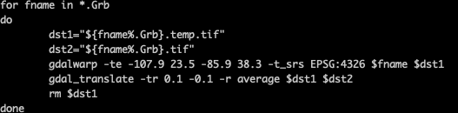
Now, some geospatial preprocessing
We need to project the data to the same extent and at the same resolution
For NCEP:

Slide 29
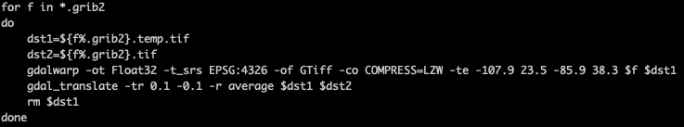
Now, some geospatial preprocessing
We need to project the data to the same extent and at the same resolution
For MRMS:

Slide 30
Let’s get into the code

Slide 31
Discussion
You can apply this framework to any other components in the hydrological cycle, such as soil moisture (Hong et al., 2022), evaporation, etc.
Pay attention to the limitations and assumptions for applying TC method!
You can even use TC weights to correct and merge three different datasets (Lyu et al., IEEE TGRS, 2020)
Can we have quadruple or even quintuple collocation?

Slide 32
Q&A
Notes:
A table of precipitation products

